Slide 1
Product Planning

Slide 2
Our Company (Project Team)
CEO:
COO:
Technology Experts:
Outsource:

Slide 3
The Product
Tell Me About Your Product
Features:
Cost:
Illustration

Slide 4
Our Business Model Canvas

Slide 5
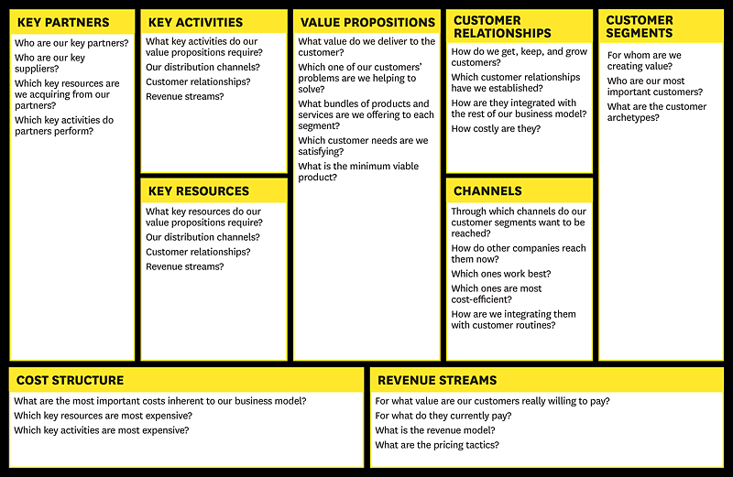
Business Model CanVAS
The plan implemented by a company to generate revenue and make a profit from operations. The model includes the components and functions of the business, as well as the revenues it generates and the expenses it incurs.

Slide 6
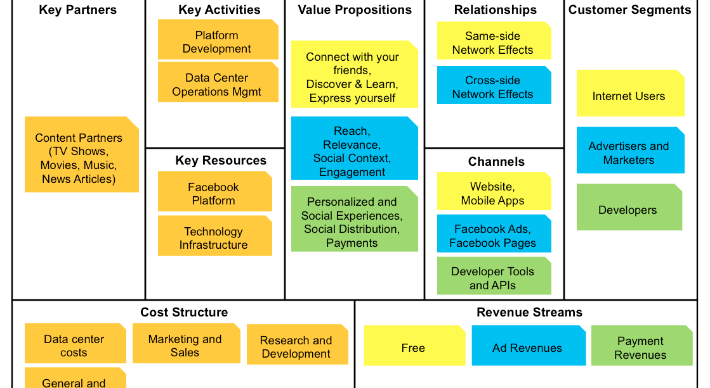
Business Model Canvas (Facebook)

